Slide 1
Waterfall Model

Slide 2
Waterfall model is a software development model that includes phases
as :
1. FEASIBILITY STUDY
2. REQUIREMENT ANALYSIS AND SPECIFICATION
3. SYSTEM DESIGN
4. CODING
5. TESTING
6. IMPLEMENTATION
7. SYSTEM MAINTENANCE
This model is based on SDLC and became popular in 1970’s.
Initially , the model introduced was Classical Waterfall Model. Then
Iterative Waterfall Model was implemented.

Slide 3
CLASSICAL WATERFALL MODEL
This model is a completely theoretical way of developing software.
This model is an idealistic one since it assumes that no development error is ever committed by the developers during any of the life cycle phases.
But the importance of this model lies in the fact that,
All other models are essentially derived from this model.
Starting from the feasibility study to testing, the phases are together known as development phase.
The implementation and maintenance phase commences after the completion of development phase.

Slide 4
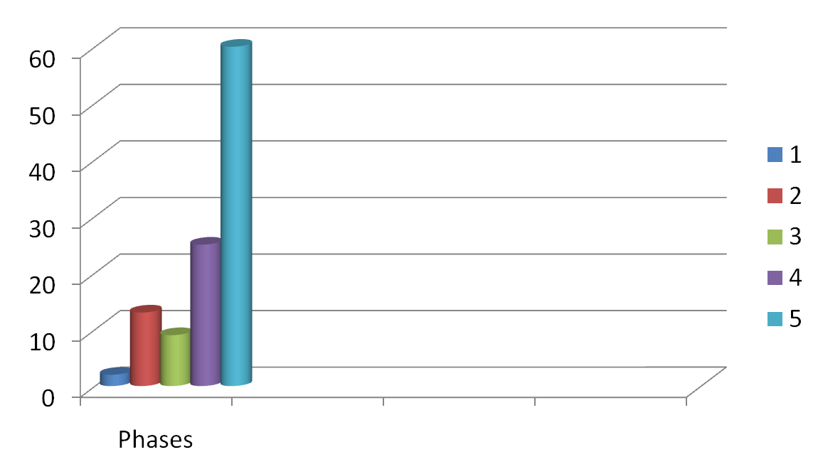
Relative effort distribution among the different phases:-
Requirement analysis and specification
Design
Coding
Testing
Maintenance

Slide 5
PROBLEMS IN CLASSICAL WATERFALL MODEL
In practical development environments, developers do commit
a large numbers of errors in every phase of development.
In most cases, the defects that occur in one phase get detected much
later in the life cycle.
Once it is detected, the developers need to go back to the phase where
the defect has occurred and redo some of the work done in that phase.
All the subsequent and related work done in the other phases are also
required to be corrected accordingly.
Therefore , a feedback path is introduced in Classical Waterfall
Model to make it an Iterative Waterfall Model.

Slide 6
ITERATIVE WATERFALL MODEL
The phases in the iterative model is the same as classical
waterfall model.
Iterative model introduces a feedback path from each
model.

Slide 7
Advantages of Waterfall Model:
Relatively simple to understand
2. Each phase of development proceeds sequentially.
3. Allows managerial control where a schedule with deadlines is set
at each stage of development.
4. Helps in controlling schedules, budgets and documentation.

Slide 8
Limitations of Waterfall Model:
In this model this is assumed that the system requirements are
known before the design phase begins. However, this is not a
practical approach.
To achieve higher and better efficiency and productivity, this rigid sequential structure imposed by the model cannot be followed.
Reason:
Sequential approach lead to huge resource wastage, as each stage
is dependent on the results of the previous stage.

